Slide 1
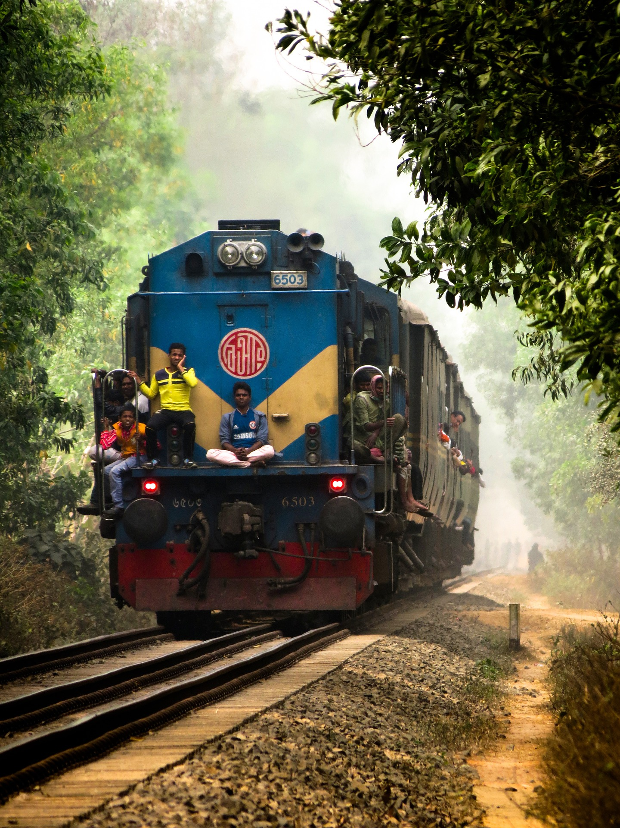
TRAIN TICKET MANAGEMENT SYSTEM
WELCOME TO
Presented By:
Md Kamruzzaman(19202103526)
Fabia Zaman Ekah (19202103225)
Habiba Rahman(19202103232)
Supervised By:
Meer Muttakin Alam
Teaching Assistant
Dept. Of CSE (BUBT)

Slide 2
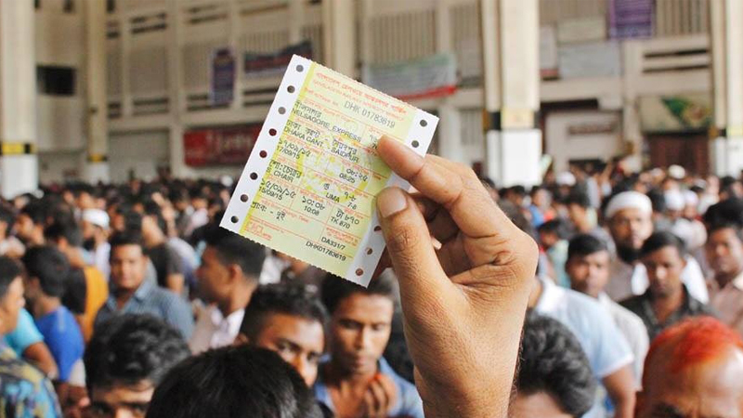
TRAIN TICKET MANAGEMENT SYSTEM

Slide 3
Outline Of This Presentation
Background
Releted project work
Proposed Model
System Requirements
Experimental Results and Evaluation
Conclusion and Future Work

Slide 4
1
BACKGROUND

Slide 5
INTRODUCTION
Purchase ticket from home.
Access train information.
Any train schedule.
Complain.
Emergency help.
User friendly.
Online Payment.

Slide 6
PROBLEM STATEMENT
Easy ticket booking.
No need to go station counter.
Know train schedule from Anywhere.
Pay online.
Plan your journey.
Order meal.
Select the seat of your choice.

Slide 7
OBJECTIVE
Degitalized ticket purchasing.
Computerized all manual work .
Suffering will end.
Easy and smoth purchasing.
Stopping black ticket.
Service all citizens.
Skilled manpower.
Profitable.

Slide 8
2
RELETED PROJECT WORK

Slide 9
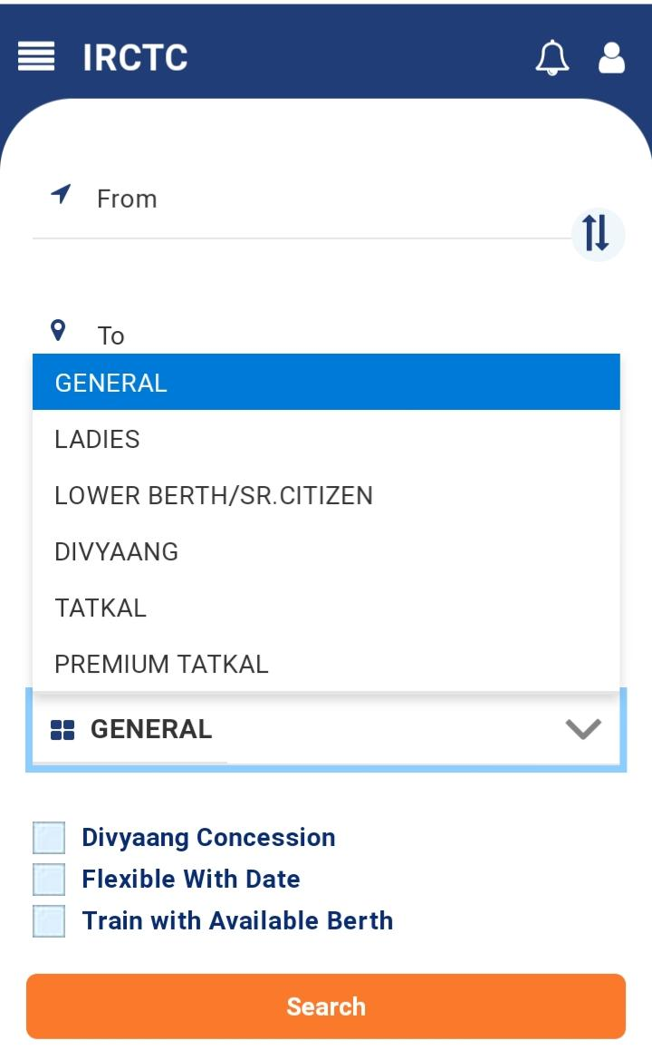
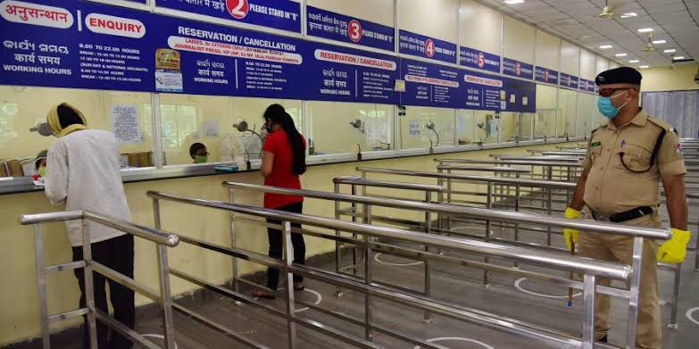
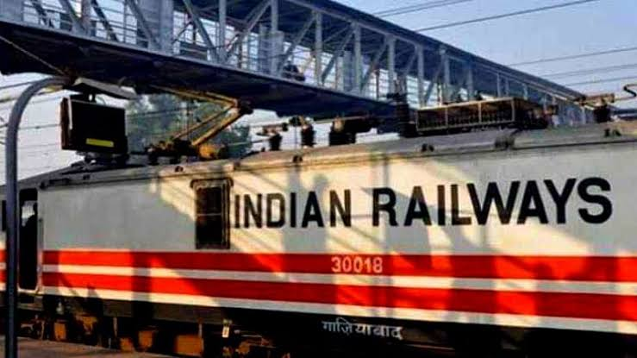
RELETED PROJECT WORK
INDIAN RAILWAY
Worlds largest train network.
Well designed system.
Separate train.
Skilled manpower.

Slide 10
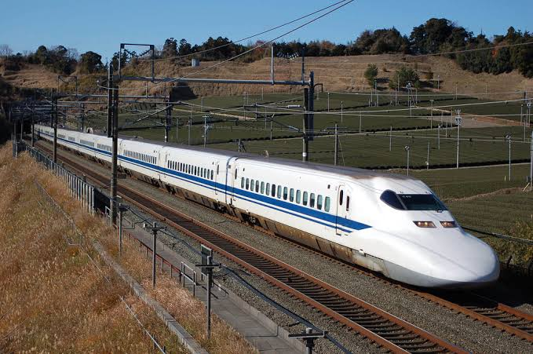
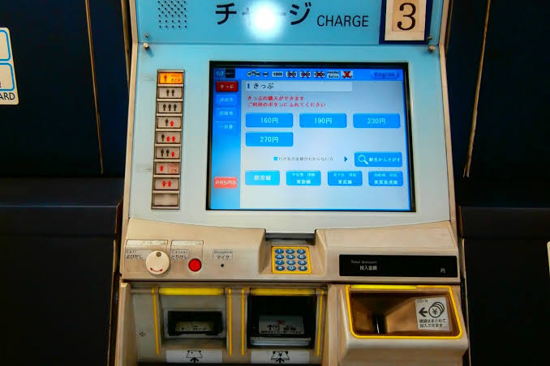
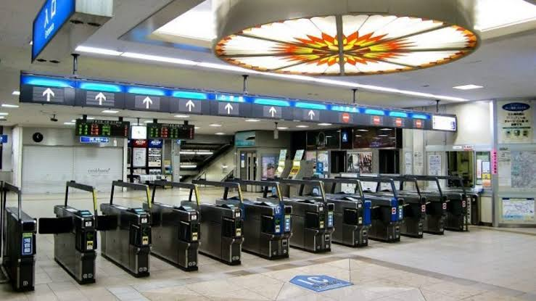
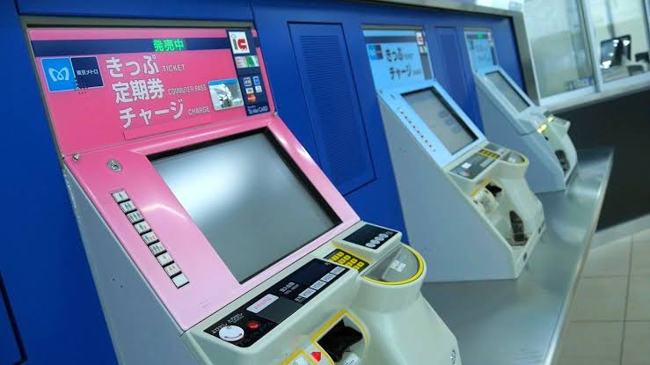
RELETED PROJECT WORK
JAPAN RAILWAY
Ticket Vending Machine(TVM).
Ticket check at the entrance.
fluent entrance .

Slide 11
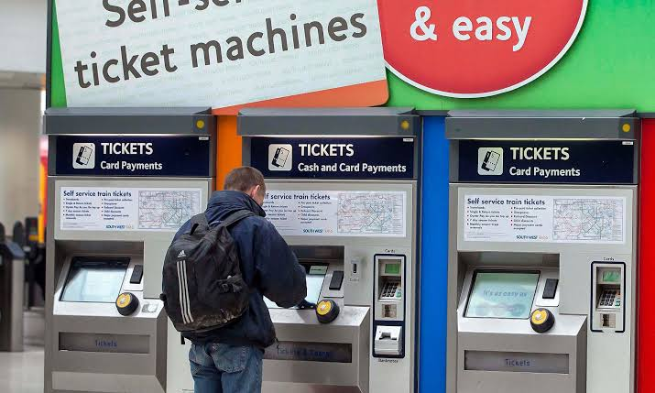
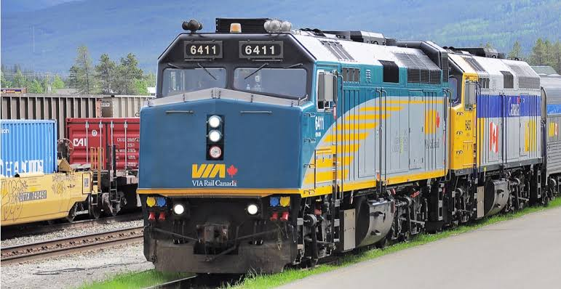
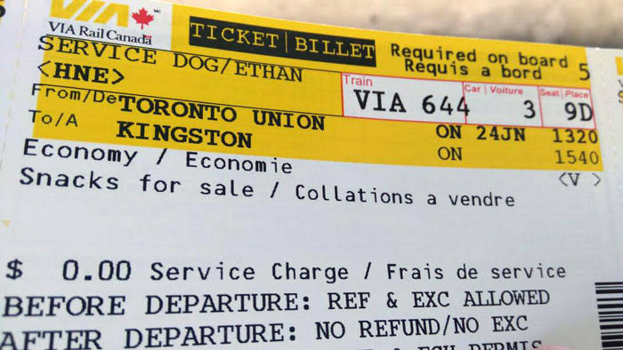
RELETED PROJECT WORK
CANADA RAILWAY
Ticket Vending Machine (TVM)
Special online ticket.

Slide 12
3
PROPOSED MODEL

Slide 13
Description Of The Proposed System
Main Window
Train schdule
Ticket purchase
LOGIN
Train Information
USER HOME
My Account
Complain
User Home
Admin Home
Emergency contract
Exit

Slide 14
Description Of The Proposed System
Add info
Show info
Admin
BOOK TICKET
Update info
GET TRAIN
Schedule
FILE
RESIGTERED USER
SHOW TICKET
Delete info
CANCEL TICKET

Slide 15
4
SYSTEM REQUIREMENTS

Slide 16
SYSTEM REQUIREMENTS
Hardware Requirements :
A Computer (mandatory)
5 GB RAM (minimum)
30 GB Hard disk (minimum)
Software Requirements:
OS : Windows 7, 8, 8.1, 10
IDE: CodeBlocks 13.12, 17.12
Documents made by : LaTeX
Programming Language:
C Language

Slide 17
5
EXPERIMENTAL RESULTS

Slide 18
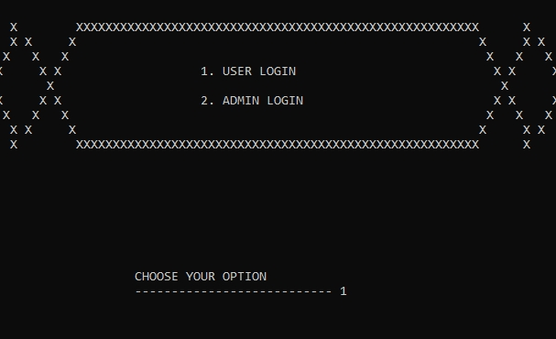
RESULT

Slide 19
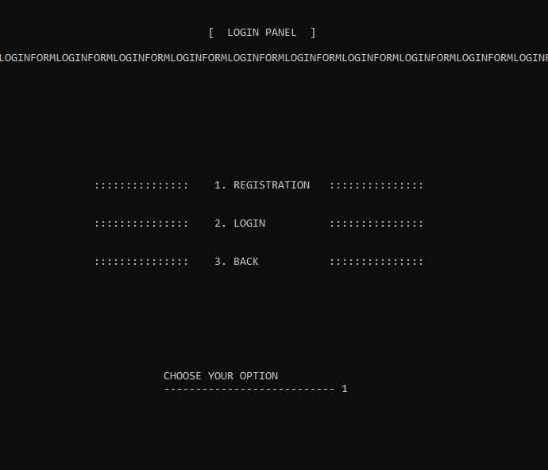
RESULT

Slide 20
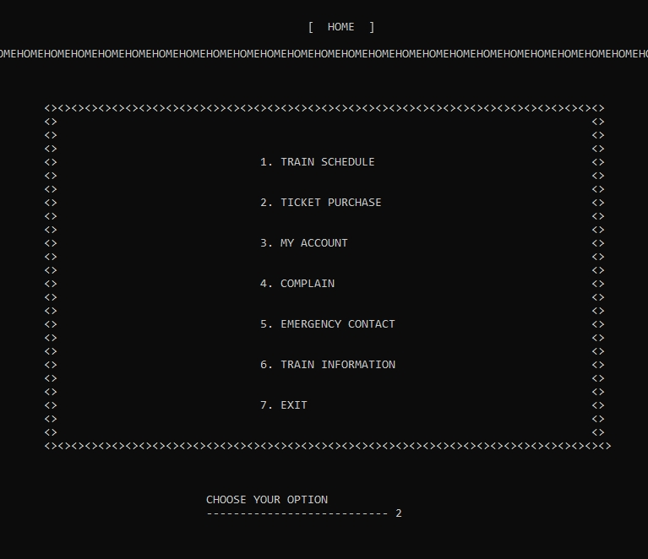
RESULT

Slide 21
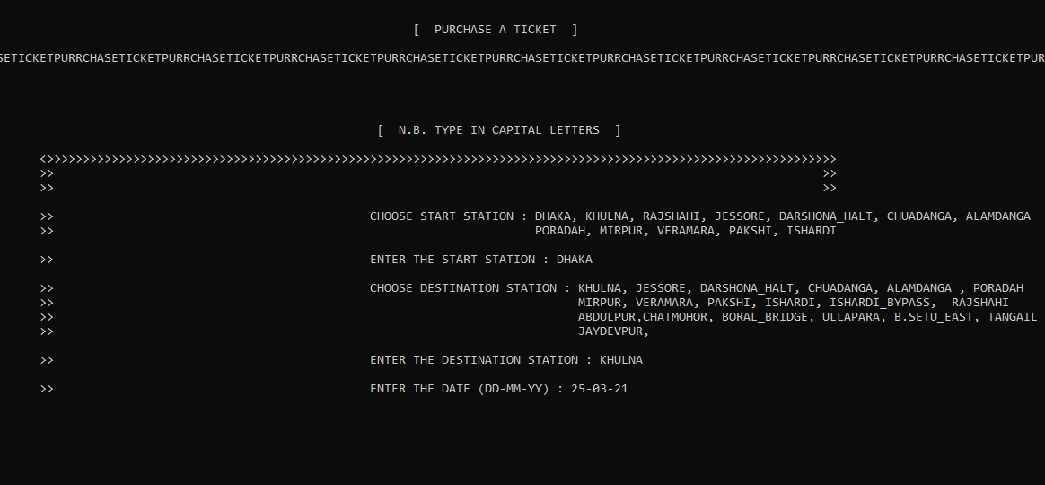
RESULT

Slide 22
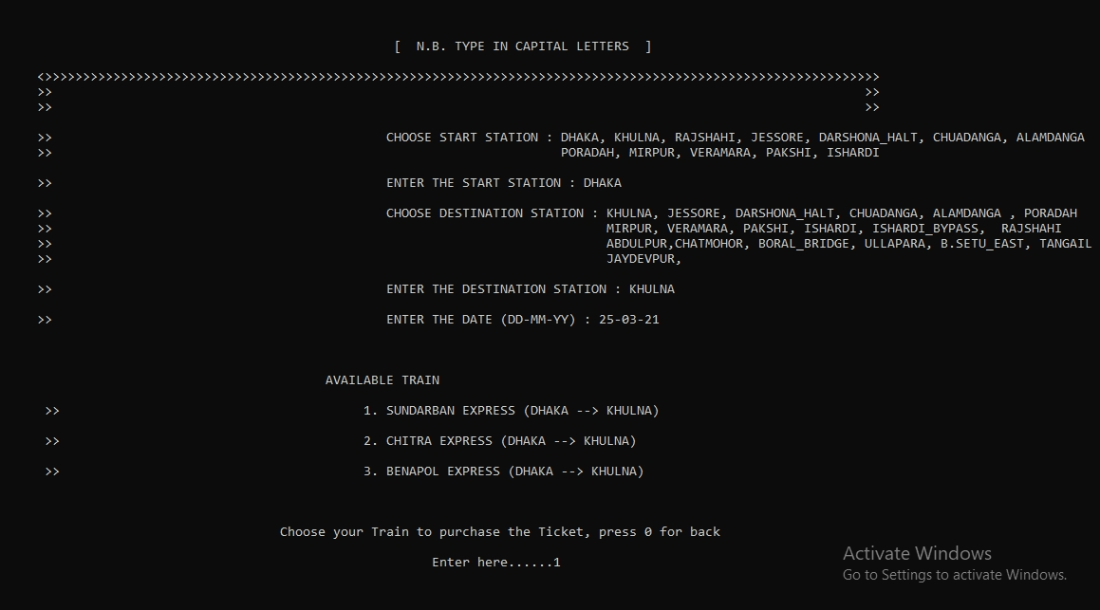
RESULT

Slide 23
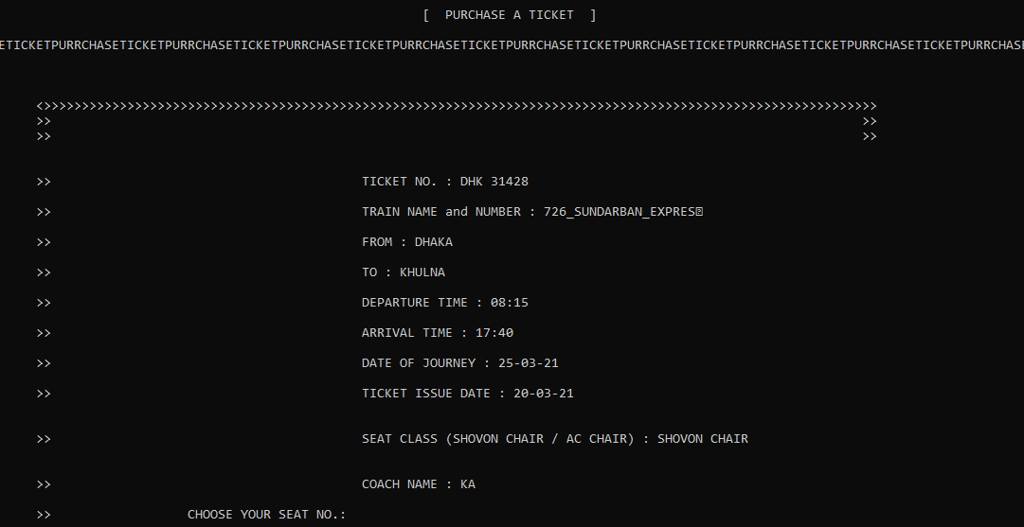
RESULT

Slide 24
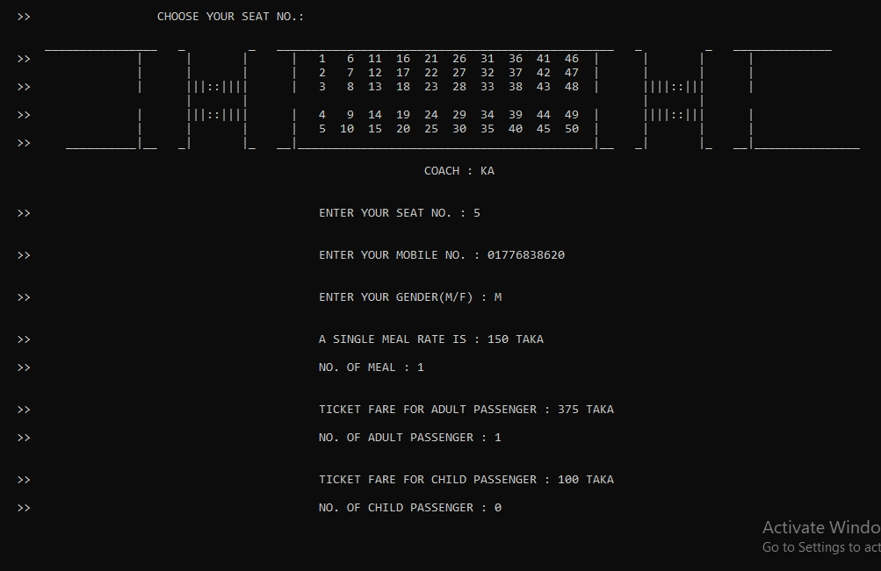
RESULT

Slide 25
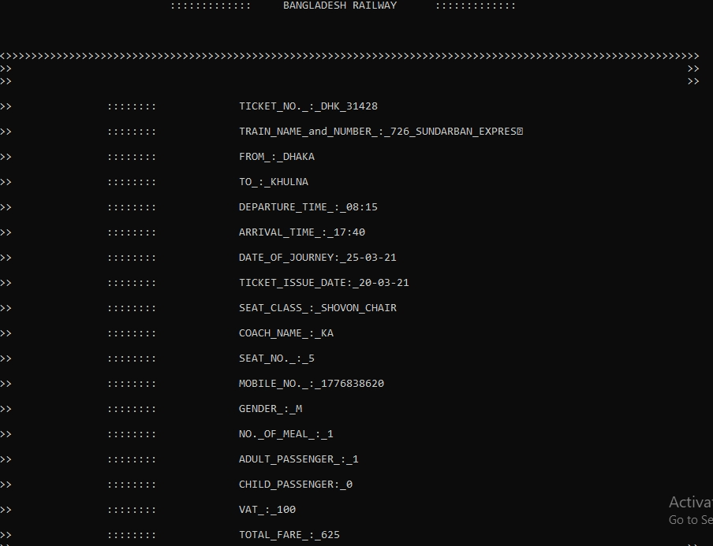
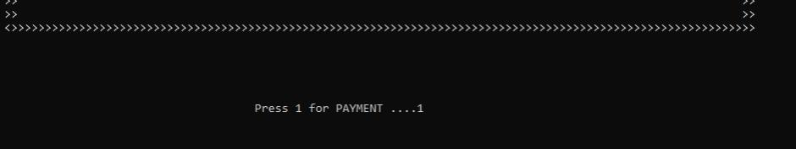
RESULT

Slide 26
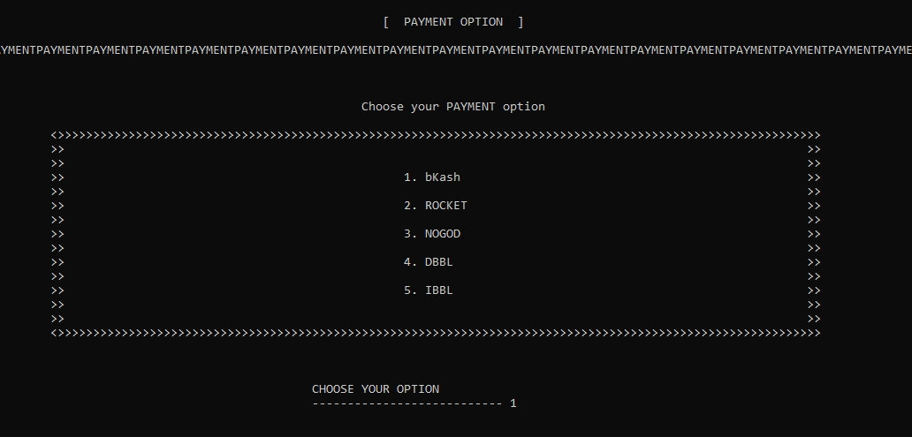
RESULT

Slide 27
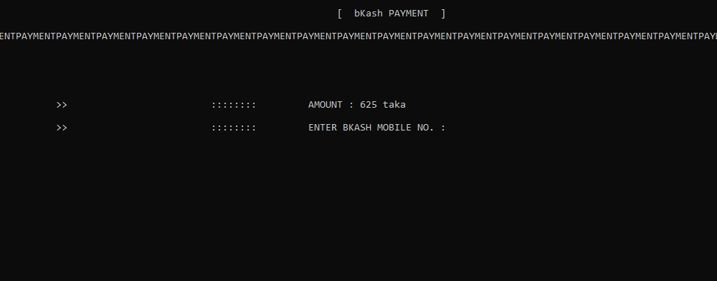
RESULT

Slide 28
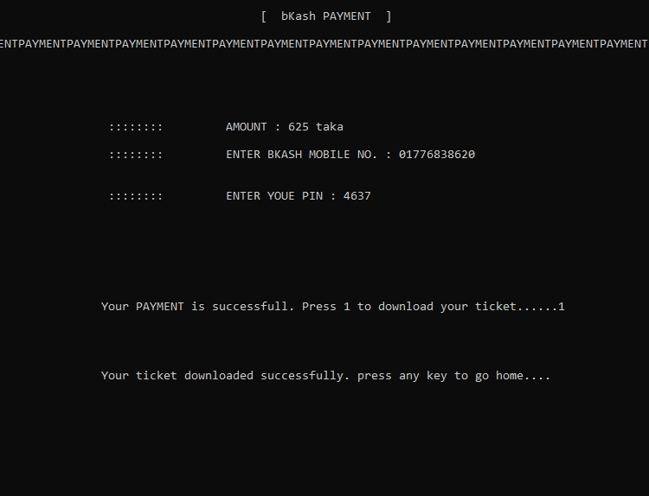
RESULT

Slide 29
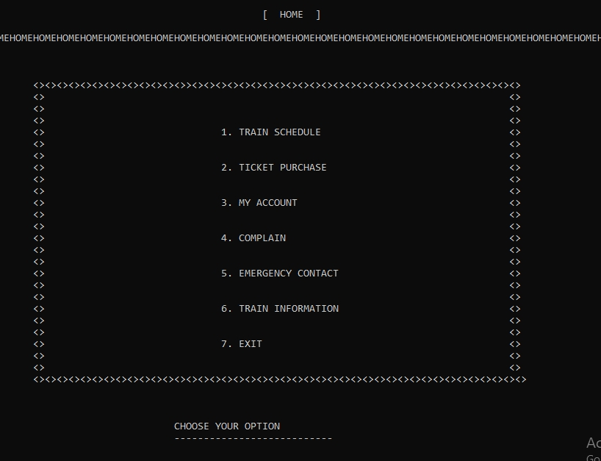
RESULT

Slide 30
6
CONCLUSION AND FUTURE WORK

Slide 31
CONCLUSION
Login system.
User module.
Admin module.
File system.
Ticket purchasing system.
Online payment system.
Account system.

Slide 32
FUTURE WORK
Public Wi-Fi.
Automatic door system.
CCTV Camera.
ID Checker at door.
Fingerprint scanner .
Face detection.
Direct communication from locopilot.
Monitor for information.

Slide 33
THANK YOU

